Slide 1

Jerry Liu
Ryne Waterson
Keith Leung
Jeffery Yeung
Scott Checko

Slide 2
Team 5: TRIWAVE SYSTEMS
Jerry Liu (CEO)
Ryne Watterson (CIO)
Keith Leung (CTO)
Jeffery Yeung (CCO)
Scott Checko (COO)

Slide 3
Presentation Overview
Background & Motivation
Business & Market Analysis
Technical System Overview
Risk Assessment
Engineering Standards
Self Reflection
Scheduled 440 Timeline
Summary & Concluding Remarks
Demo
Questions

Slide 4
Introduction

Slide 5
Background
Approx. 500,000 commercial buildings in Canada [1]
Modern emergency response methods could be optimized
Limited information on arrival
Victim location based on witness accounts
Unreliable and creates room for human error
135 fire deaths per year from 2010-2014 [2]
Introduction | Market Analysis | Technical Overview | Risk Assessment | Standards | Reflection | 440 Timeline | Summary

Slide 6
Motivation
Modernize safety in urban/industrial environments
More buildings & people in small areas
Access to these areas more difficult
What happens when disaster strikes?
Increase efficiency of emergency response teams
More information
On-the-fly changes
Limit human error
Safer for first responders
Introduction | Market Analysis | Technical Overview | Risk Assessment | Standards | Reflection | 440 Timeline | Summary

Slide 7
Akriveia Beacon System
Indoor Positioning System (IPS)
Designed for Disaster Search & Rescue Operations
System of Anchor Beacons and Wearable ID Tags
Integrated with Advance Ultra-Wideband (UWB) Technology
Trilateration Methods for Tracking
Near Real-Time Indoor Tracking
Introduction | Market Analysis | Technical Overview | Risk Assessment | Standards | Reflection | 440 Timeline | Summary
Notes:
An indoor positioning system designed for DSRO
System of Anchor Beacons and Wearable ID Tags integrated with Advance Ultra-Wideband (UWB) Technology
Uses trilateration methods to determine location
Can track in near real time

Slide 8
Indoor Positioning Systems (IPS) Attributes [3]
System accuracy and precision
Coverage and resolution
Latency in making location updates
Building’s infrastructure impact
Effect of errors on the system such as signal interference and reflection
Introduction | Market Analysis | Technical Overview | Risk Assessment | Standards | Reflection | 440 Timeline | Summary
Notes:
For any IPS there are 5 main attributes to be considered

Slide 9
Business & Market Analysis

Slide 10
Business & Market
Search and Rescue (SAR) Equipment Market in 2017: $113.62 billion [4]
Projected in 2022: $125.66 billion
Global Indoor Location (GIL) Market in 2015: $3.43 billion [5]
Projected in 2022: $29.4 billion
Introduction | Market Analysis | Technical Overview | Risk Assessment | Standards | Reflection | 440 Timeline | Summary
Notes:
One great benefit to our product is that it’s uniquely place between two large markets: The Search and Rescue equipment and the Global Indoor Location markets
SAR equipment is an old existing market and encompasses emergency vehicles such trucks or helicopters to rescue responders devices such as our beacons and ID tags.
It’s estimated to be at $113.62 billion dollars industry in 2017 and is expected to reach 125.66 bil in 2022.
On the other hand, GIL is an emerging market after the proliferation of smartphone users but also the ineffectiveness of GPS for indoor tracking.
Currently the market is at 3.43 bil in 2015 and is expected to surpass $29.4 bil in 2022.

Slide 11
Target Markets
Ideal Customers
Commercial Building owners or property management companies
Need for GIL for occupants in emergencies
Government Incentives
System increases occupant safety in emergency situations
Easily integrated into Building Code - Fire Safety
Reduces risk to emergency personnel
Introduction | Market Analysis | Technical Overview | Risk Assessment | Standards | Reflection | 440 Timeline | Summary
Notes:
Currently our ideal target market is the Commercial Building owners or property management companies
These are two major audiences that would most likely invest in our products. We saw a need for GIL tracking for occupants in emergencies
As well, we are considering to petition for Gov’t incentives to be applied for our product. The reasons being that
Our system increases the occupant safety in emergency situations or the likelihood of being rescued
We are focused on occupant localization during fire emergencies. It could be easily added into the Building Code under Fire safety
Finally, the most important reason is the benefit of reducing risk to emergency personnels, allowing them to go into the fire after being aware of occupant’s locations

Slide 12
Competition
Same Technology, Different Application
Production & Logistics |  | Medical & SAR
Pozyx UWB Tag + Node Expensive | Infsoft UWB/BLE Tag + Node Privacy issue | KAUST Innovation UWB Handheld Device Operator Dependency
Introduction | Market Analysis | Technical Overview | Risk Assessment | Standards | Reflection | 440 Timeline | Summary

Slide 13
Project Budget and Funding
Current Expenses (Up-to-Date)
$461.46
Expected Project Total Budget
$1000
Funding Estimates
$500
Introduction | Market Analysis | Technical Overview | Risk Assessment | Standards | Reflection | 440 Timeline | Summary
Notes:
Expenses include circuits, breadboards, usb cables, pcbs and arduino kits
Funding by
ESS Endowment Fund
Whiiten Fund

Slide 14
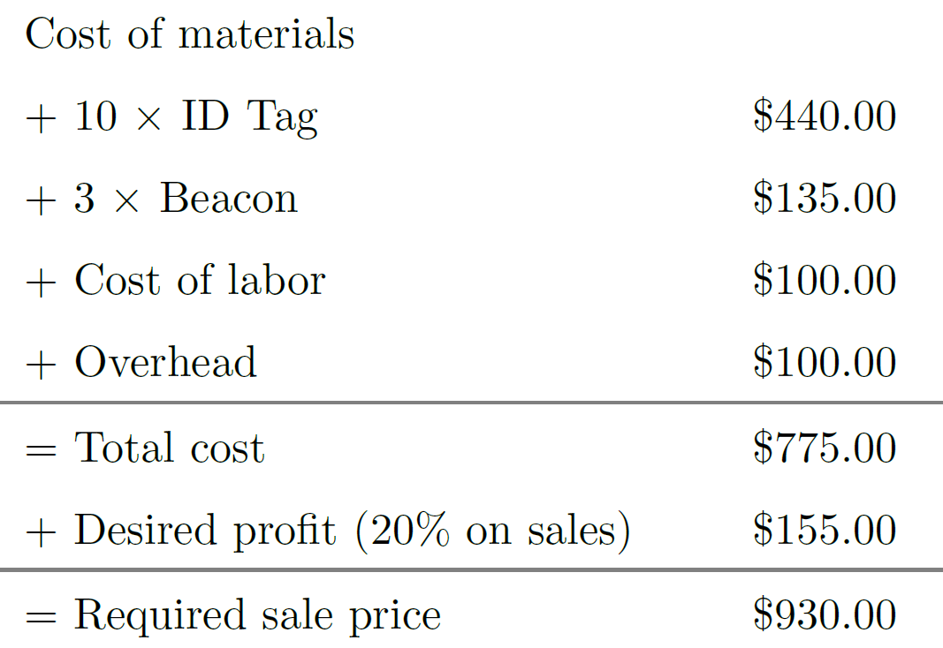
Project Pricing
System Price for 3 beacons & 10 ID tags
$930.00
Additional Beacon & ID tag unit costs
$45/Beacon & $44/ID tag
Software Cost
$200/year
Introduction | Market Analysis | Technical Overview | Risk Assessment | Standards | Reflection | 440 Timeline | Summary
Notes:
Our product is currently priced at $930 for one system incl. 3 beacons and 10 ID tags. However, after we finalize production and start outsourcing manufacturing, our current product expenses should reduce to so as to gain significantly more profit.
Additional Beacons and ID tags cost $45 and $44 respectively.
Our plan is to price our software services at $200/year. This would grant us continual income flow after the initial sale. After more intensive market research, our product pricing will change.

Slide 15
Technical System Overview

Slide 16
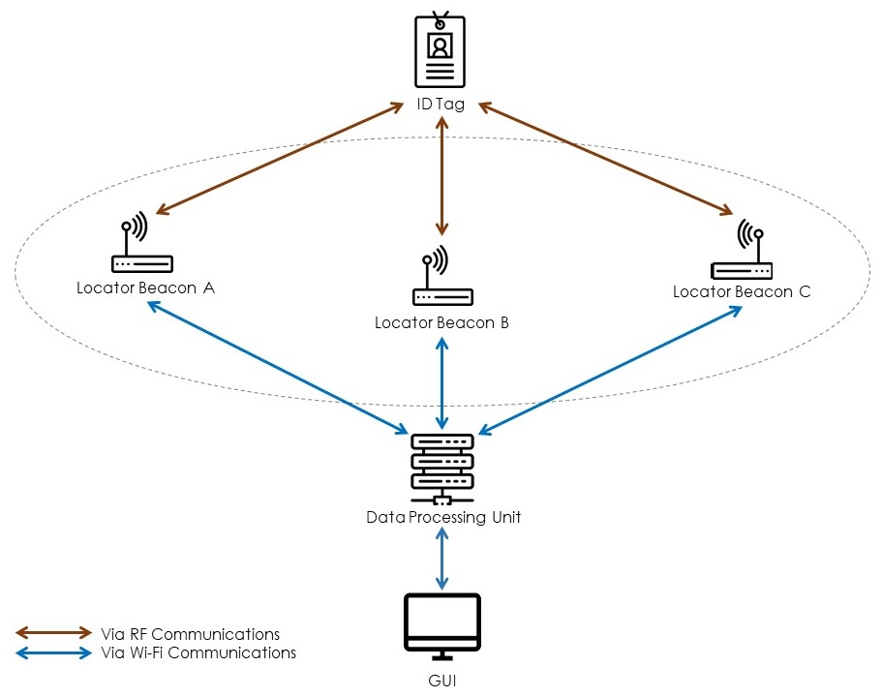
System Layout
Akriveia Beacon Consists of:
Locator Beacons
Wearable Tracker ID Tags
Data Processing Unit (DPU)
Introduction | Market Analysis | Technical Overview | Risk Assessment | Standards | Reflection | 440 Timeline | Summary
Notes:
ABS is a system of indoor Locator Beacons which can track wearable ID tags using rf signals in the UWB spectrum
Each beacon can detect the distance between itself and an ID tag
and using a Private Wifi network the distance data can be forwarded to a DPU for trilateration processing
The final location info is displayed to the first responders through a GUI

Slide 17
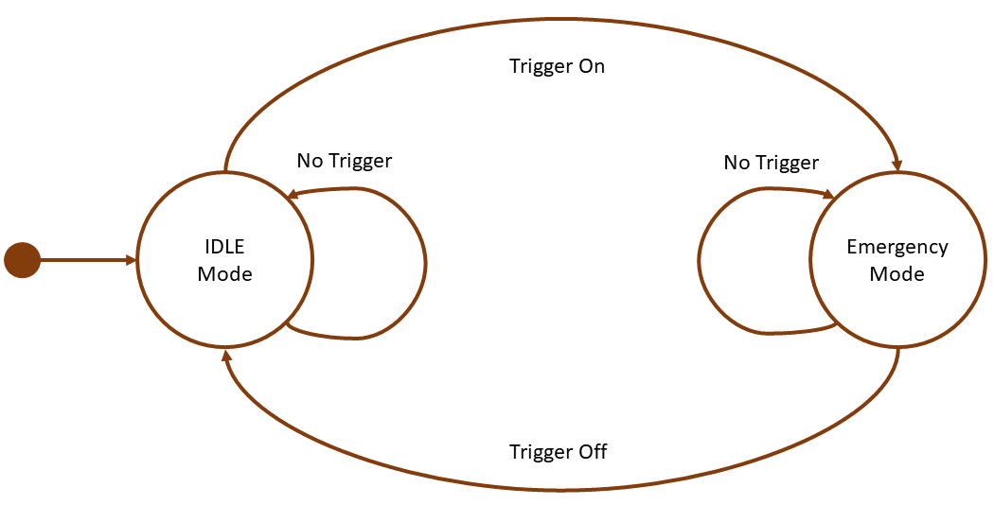
System Operation Modes
Introduction | Market Analysis | Technical Overview | Risk Assessment | Standards | Reflection | 440 Timeline | Summary
Notes:
The system will operate under two modes: idle and emergency mode
during idle mode Rf communication is off and tracking is disabled to prevent privacy breaches
During emergency mode beacons and ID tags establish rf communication pipeline to enable location tracking

Slide 18
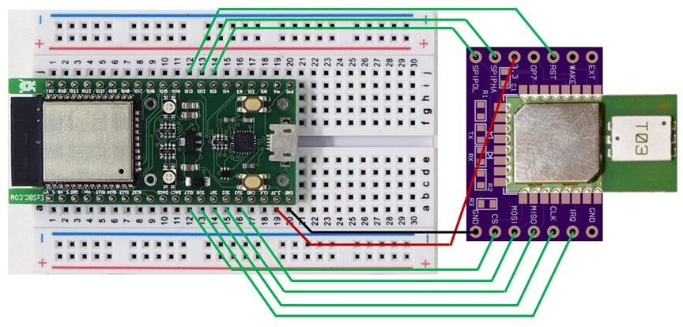
ID Tags & Beacons Architecture
Composed of:
Espressif ESP32
Decawave DWM1000
Communicate via SPI
Introduction | Market Analysis | Technical Overview | Risk Assessment | Standards | Reflection | 440 Timeline | Summary
Notes:
Each id tag and anchor is composed of an esp32 MCU
And a decawave DWM1000 UWB transceiver module
The two components communicate with each other using Serial Peripheral Interface (SPI)

Slide 19
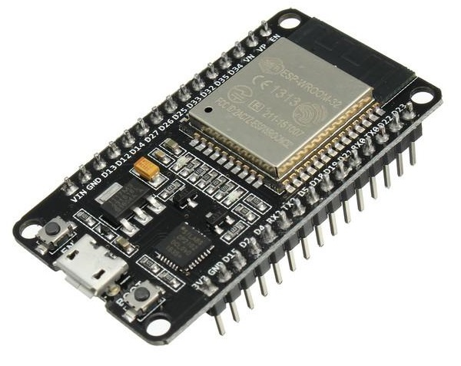
ESP32 Microcontroller Unit
Tensilica Xtensa 32-bit LX6 microprocessor
Operate @ 160/240 MHz
Integrated WiFi/Bluetooth
Touch sensor pins
Deep sleep low-power modes
Low-cost
Notes:
Esp32 are low-cost system on a chip microcontrollers
Each contains a 32-bit Tensilca microprocessor with integrated Wi-Fi and dual-mode Bluetooth
It also provides very efficient power saving capabilities which is vital for wearable electronics

Slide 20
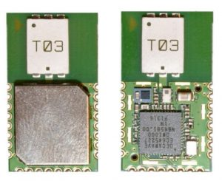
Decawave DWM1000 UWB Module
Operation Frequency Range of 3.5 to 6.5 GHz
802.15.4-2011 UWB compliant
FCC/ETSI Certified
Precision of up to 10 cm indoors
Excellent ranges of up to 300m
High range of communications data rates
Notes:
The decawave DWM1000 UWB modules are RF modules that operate in the range of 3.5 to 6.5 Ghz
And are Low-Rate Wireless Networks compliant
These modules provide tracking up to 10 cm indoors
They can also reach up to 300m with very high communications data rates

Slide 21
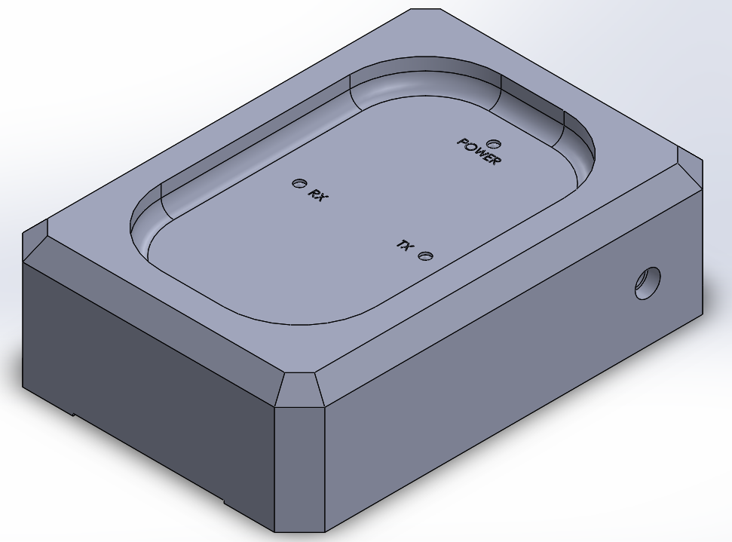
Anchor Beacons
Stationary transceiver devices
Communicate via UWB transceivers
Battery Backups
Requires minimum of 3 for tracking
Communicate with DPU via private WiFi network
Introduction | Market Analysis | Technical Overview | Risk Assessment | Standards | Reflection | 440 Timeline | Summary
Notes:
Beacons are stationary high mounted transceiver devices
Located on walls, pillars and any location with good structural integrity
Using the same uwb models as the ID tags for rf communication
For trilateration to work a minimum of 3 beacons is required

Slide 22
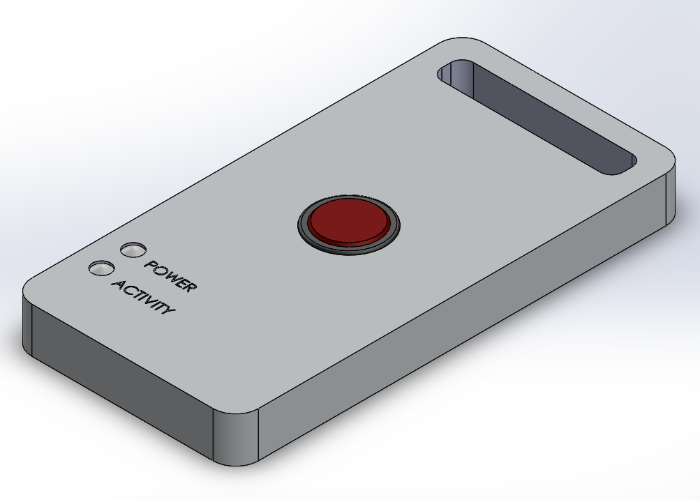
ID Tags
Small wearable electronic tagging devices
Uses similar UWB transceivers
Light and Durable
Efficient Power saving modes
Touch sensor activation
Integration with access cards or key fobs
Introduction | Market Analysis | Technical Overview | Risk Assessment | Standards | Reflection | 440 Timeline | Summary
Notes:
Each ID tag is small wearable electronic device integrated with MCU and UWB transceivers
They are light, durable, and provide sustainable power saving options
The plan was to integrate with access cards or key fobs for every carry
And during an emergency any personnel trapped can toggle ID tags on and broadcast their location

Slide 23
Power Management

Slide 24
Beacon Power Management
Beacons
Switching circuitry
Main power
Battery power
9V 4000 mAH backup
Switching circuit
120V AC 60Hz
9V
Beacon
Introduction | Market Analysis | Technical Overview | Risk Assessment | Standards | Reflection | 440 Timeline | Summary

Slide 25
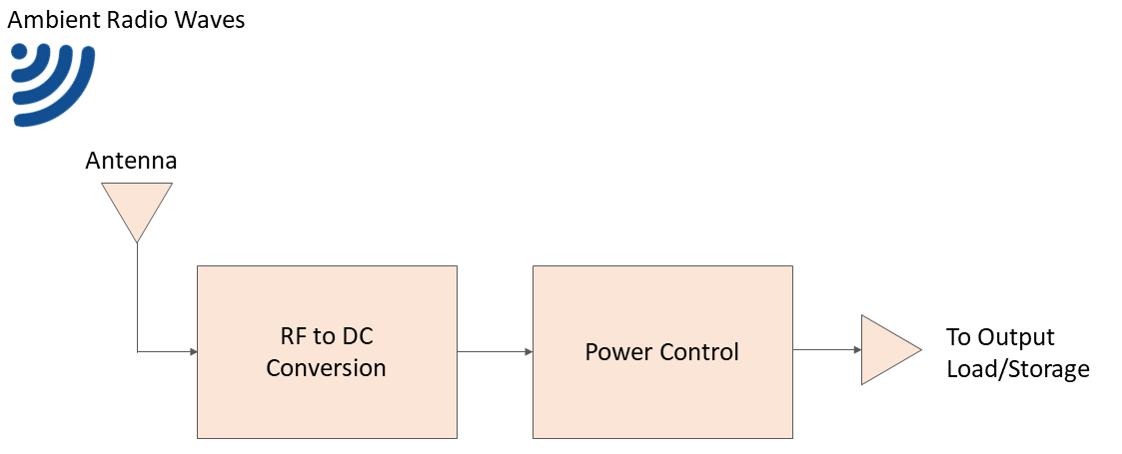
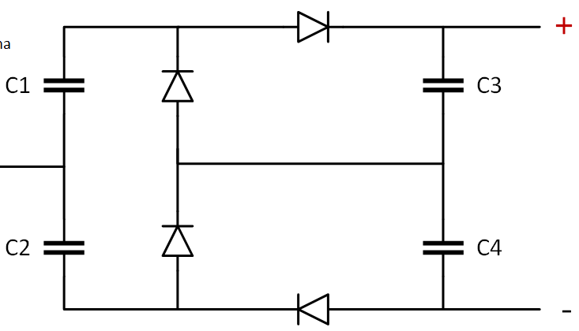
ID Tag Power Management
Long battery life
Rechargeable 2000 mAH Li-ion
Deep-sleep mode
RF Harvester
Introduction | Market Analysis | Technical Overview | Risk Assessment | Standards | Reflection | 440 Timeline | Summary

Slide 26
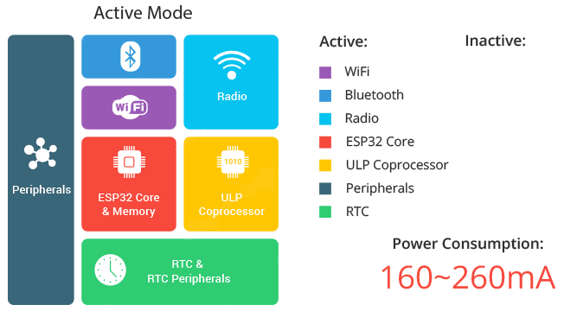
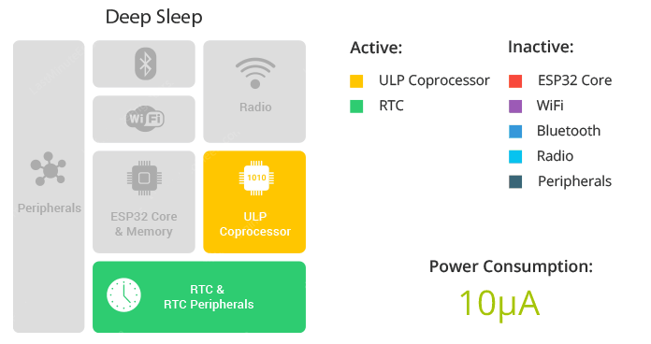
ESP32 Activity Modes
Active
Much higher power
Only during emergency
Activated via button
Deep Sleep
Low Power mode
Extended Battery Life
Low maintenance cost
Preserves user privacy
Introduction | Market Analysis | Technical Overview | Risk Assessment | Standards | Reflection | 440 Timeline | Summary
Notes:
Calculation show ID tags can last up to 20 years on a 2000mAH battery

Slide 27


Battery Life Calculations
Active
Deep Sleep
Introduction | Market Analysis | Technical Overview | Risk Assessment | Standards | Reflection | 440 Timeline | Summary
Notes:
Even 5x more power consumption than advertised and it will still last 4 years

Slide 28
RF Ranging & Trilateration

Slide 29
RF Ranging Method
Received Signal Strength Indicator (RSSI) Based Approach
Conversion of RSSI to distance
Employed in PoC phase
Bluetooth Low Energy (BLE)
Inverse Square Law
Prone to multipath fading and interference
Time-of-Flight (ToF) Based Approach
Employed in Prototype phase
Ultra-Wideband (UWB)
Signal propagation time
Distance Speed Time Formula
Effective against noise and multipath
Introduction | Market Analysis | Technical Overview | Risk Assessment | Standards | Reflection | 440 Timeline | Summary
Notes:
RF Ranging is the measurement of distance between transmitter and receiver using metrics that can be retrieved from RF technologies.
Two approaches: Received Signal Strength Indicator and Time-of-Flight, using two different RF technology
RSSI is employed in PoC phase using Bluetooth Low Energy Radios as our tags and beacons, which operates on the 2.4GHz frequency
Since RSSI behaves in accordance to the ISL, which states that signal strength decreases per squared distance from the source, RSSI can be used to approximate distance between sender and receiver
RSSI is an great metric for proximity rather than true distance as it is very vulnerable to multipath fading and interference
The alternative, time of flight based approach will be used in the prototype phase and measured with ultra-wideband radios
Time-of-flight describes the signal travel time from its emission to its return to the source
EM waves travel at speed of light, hence with time-of-light measurement, distance can be calculated

Slide 30
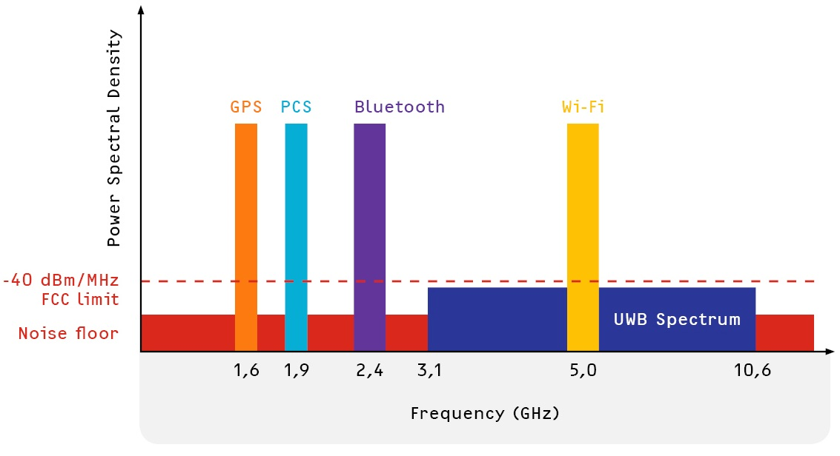
Ultra-Wideband Spectrum
Short duration pulses
Low transmit power
Minimal interference
High data rate
Introduction | Market Analysis | Technical Overview | Risk Assessment | Standards | Reflection | 440 Timeline | Summary

Slide 31
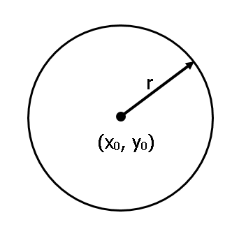
Trilateration Method
Standard Form of a Circle:
(x - x₀)² + (y - y₀)² = r²
where,
(x₀, y₀) are the cartesian coordinates of a beacon
r is the distance derived from RF ranging
Introduction | Market Analysis | Technical Overview | Risk Assessment | Standards | Reflection | 440 Timeline | Summary

Slide 32
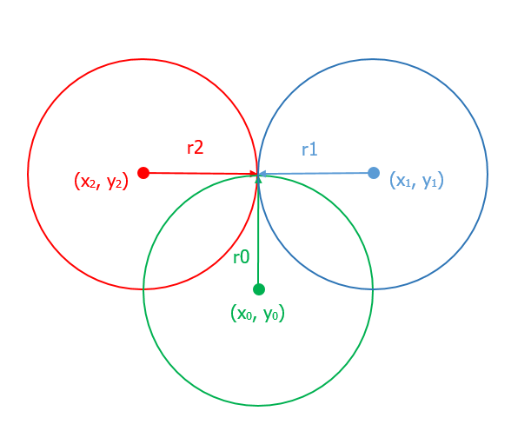
Trilateration Method
Two Dimensional Trilateration:
(x - x₀)² + (y - y₀)² = r₀²
(x - x₁)² + (y - y₁)² = r₁²
(x - x₂)² + (y - y₂)² = r₂²
Introduction | Market Analysis | Technical Overview | Risk Assessment | Standards | Reflection | 440 Timeline | Summary

Slide 33
Software

Slide 34
Software Overview
 | Client | Web Server | Data Processing | Beacons | ID Tags
Language | Rust | Rust | Rust | C++ | C++
Location | Browser | DPU | DPU | Throughout the building | Employees
Major Framework | Yew | Actix Web | Actix | Arduino Runtime | Arduino Runtime
Purpose | Display data and maps, user interaction | Respond to requests from client | Trilateration calculations | TOF and RSSI calculations | Reply to beacons
Introduction | Market Analysis | Technical Overview | Risk Assessment | Standards | Reflection | 440 Timeline | Summary
Notes:
Frontend and server are rust
Arduinos use c++
Frontend -> webserver -> data processing -> beacons -> id tags
Primary funcitonality of the client is to handle user GUI

Slide 35
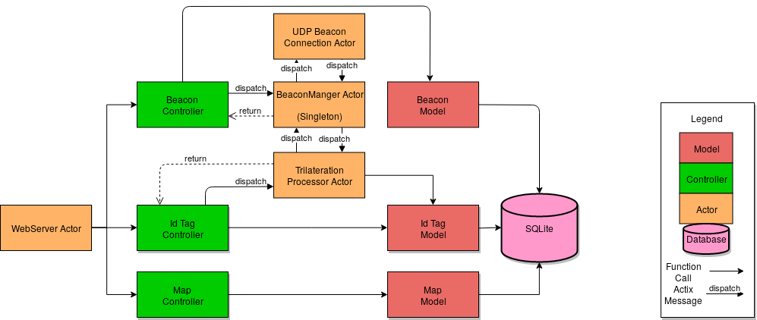
DPU Software Architecture
Introduction | Market Analysis | Technical Overview | Risk Assessment | Standards | Reflection | 440 Timeline | Summary
Notes:
The server is the most complicated software component in akriveia
Controllers and models are just a collection of functions
Actors are base unit of parallel computation -> make use of hardware

Slide 36
DPU Framework - Actix
Server side
Actor framework
Inter-thread communication via message passing
Multithreading out of the box - no deadlocks
Base for Web Server library “Actix Web”
Asynchronous single threaded execution
Supports non blocking IO for files and database operations
Data processing
Trilateration computation
User request handling
Database interaction
Beacon request handling
Introduction | Market Analysis | Technical Overview | Risk Assessment | Standards | Reflection | 440 Timeline | Summary
Notes:
Compared to the competing rust packages, actix was a more complete package - model view controller + backend

Slide 37
DPU Framework - Yew
Client side - browser
Makes use of Rust to Web-Assembly cross compilation
Faster than plain Javascript
Similar to Actix
unified codebase
Generates HTML on the browser to build dynamic web pages
Easy to develop against
Performant enough for a 2D application
User interaction
System configuration
Map viewing
Login/Logout
Introduction | Market Analysis | Technical Overview | Risk Assessment | Standards | Reflection | 440 Timeline | Summary
Notes:
Similar to actix but compiled to web assembly and executed on the browser
Single set of files sent to browser, after that akriveia only uses REST
Yew generates html for the browser to display

Slide 38
Software Costs
Software | Cost | License
Rustc Compiler | Free | Apache & MIT [6]
ESP32 | Free | GNU Lesser General Public [7]
Actix | Free | Apache or MIT [8]
Actix Web | Free | Apache or MIT [9]
Yew | Free | Apache or MIT [10]
GCC Compiler | Free | GPLv3 [11]
Note: List is non-exhaustive.
Introduction | Market Analysis | Technical Overview | Risk Assessment | Standards | Reflection | 440 Timeline | Summary
Notes:
All software costs are free internally.
We use all open source packages

Slide 39
Risk Assessment

Slide 40
Risk
Categories of Potential Risks
Management Risks | Technological Risks | External Risks
Cost Schedule Logistical | System Failure Software Bugs Performance | Market Legal External Hazards
Introduction | Market Analysis | Technical Overview | Risk Assessment | Standards | Reflection | 440 Timeline | Summary
Notes:
The three categories of risks we located are Management, Technological and External Risks.
Management risks pertain to possibilities of error in running company operations. These include escalating cost, delayed project schedule and any logistical issues from production or shipping.
Technological risks are risks that prevents our system from meeting performance expectations. These contain possible component or system failures, possible software bugs and inconsistent performance issues.
Possible external risks out of our control may include a change in user market or financial markets, possible patent or litigation situations and external factors such as fires or natural disasters.

Slide 41
Remediation
Stakeholders incoherent with project definition/scope
Solution: Clarify project scope
Project schedule is delayed due to logistical issues
Solution: Prioritize project timeline
Beacons are destroyed or rendered offline during emergency
Solution: Multiple redundant backups
System generates inaccurate data which increases SAR times
Solution: Calibration
Introduction | Market Analysis | Technical Overview | Risk Assessment | Standards | Reflection | 440 Timeline | Summary
Notes:
We chose the most severe risks and provided remediation strategies against them.
First one, Stakeholders have unrealistic expectations or are unclear on project scope
To solve this, we define our project scope in documentation or communication clearly in discussion/meetings.
If there is a delay in our project schedule because of shipping, manufacturing or purchasing of materials. Our steps to combat delays would be
Planning purchases in advance
Research about vendors and asking for prototype copies
Have backup vendors in case of emergencies
Another risk may be that our Beacons are destroyed or rendered offline during emergencies
To solve this issue, we dispersed multiple beacons throughout the floor. Our system needs only three working beacons in the vicinity.
The last issue may be that our Location of ID tags are inaccurate. This is mitigate in our installation. We 1.
Calibrate environment and complete system test drills
Check for accuracy and reliability of location. Whether it shows the correct ID tag locations.

Slide 42
Engineering Standards

Slide 43




Adherence to Standards
Factors to consider:
UWB in commercial environments
Wearable Technologies
Software Security/Design
Emergency Equipment Standards
Introduction | Market Analysis | Technical Overview | Risk Assessment | Standards | Reflection | 440 Timeline | Summary
Notes:
For our engineering standards, we considered these four factors to determine which standards to choose.
Using UWb in commercial environments
Standards of wearable technologies
Software security and design
Emergency equipment standards

Slide 44
Adherence to Standards
Standard | Purpose
ISO/IEC 26907:2009 | Information technology -- Telecommunications and information exchange between systems -- High-rate ultra-wideband PHY and MAC standard
ISO/IEC 24730-62:2013 | Information technology -- Real time locating systems (RTLS) -- Part 62: High rate pulse repetition frequency Ultra Wide Band (UWB) air interface
IEEE 1621-2004 | User Interface Elements in Power Control of Electronic Devices Employed in Office/Consumer Environments
IEEE P360 | Standard for wearable consumer electronic devices
IEC 62366-1 | Guidance on Usability engineering for software
C22.2 NO.0.23-15 | General Requirements for Battery-Powered Appliances
IEEE 802.15.4 | Low-Rate Wireless Personal Area Networks
Introduction | Market Analysis | Technical Overview | Risk Assessment | Standards | Reflection | 440 Timeline | Summary
Notes:
Here are the list of standards that are relevant to our project and that we have decided to adhere.

Slide 45
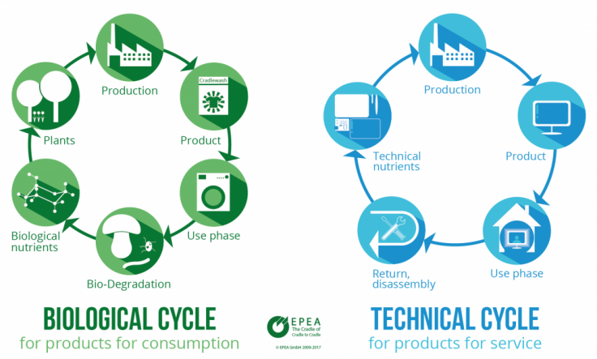
Sustainability Considerations
Cradle to Cradle Philosophy
Repurposable or recyclable
Manufactured with biodegradable non-toxic Polylactic acid plastics
Long-term Power sustainability
Introduction | Market Analysis | Technical Overview | Risk Assessment | Standards | Reflection | 440 Timeline | Summary
Notes:
Our efforts to become an environmentally progressive company means we advocate a cradle to cradle philosophy.
We make sure to repurpose or recycle product parts.
Our manufacturing uses biodegradable non-toxic polylactic acid plastics
And we aim to provide long-term power sustainability

Slide 46
Self Reflection

Slide 47
Reflection
Weekly meetings with agenda and minutes
Clear communication is critical
Time management is vital to success
Good use of online collaboration - GitLab
Overall our team’s skills and attitudes complement each other
Introduction | Market Analysis | Technical Overview | Risk Assessment | Standards | Reflection | 440 Timeline | Summary
Notes:
After this first phase of Capstone, we reflected on our project progress and we noticed these aspects that contributed to our team’s success.
First a consistent weekly meeting allows us to update each other on project progress/individual tasks. As well it was a time to build comradeship. We also have meeting minutes to document issues or to allocate tasks to be done.
We communicated clearly on discord or in person to delegate responsibilities.
Time management is a huge factor for any project but we adhered to allocating sufficient time for tasks and following our schedule.
And we utilized online collaboration tools such as Gitlabl
Also surprisingly our team’s skills and attitudes synergizes with each other. Each of our strengths and weaknesses complement one another.

Slide 48
Progress
PoC
Prototype
Final Product
Introduction | Market Analysis | Technical Overview | Risk Assessment | Standards | Reflection | 440 Timeline | Summary
Notes:
Did doc + poc
Purchases part + assembly prototype

Slide 49
Brief Plan for ENSC 440
Beta Prototype
To be completed mid-semester (OCT-NOV)
Integration of UWB
Development of software stack
Improve all hardware aspect to meet requirements
Production Ready Prototype
To be complete by end of ENSC 440 (DEC)
Final Version of Akriveia Beacon
Usability testing
Introduction | Market Analysis | Technical Overview | Risk Assessment | Standards | Reflection | 440 Timeline | Summary

Slide 50
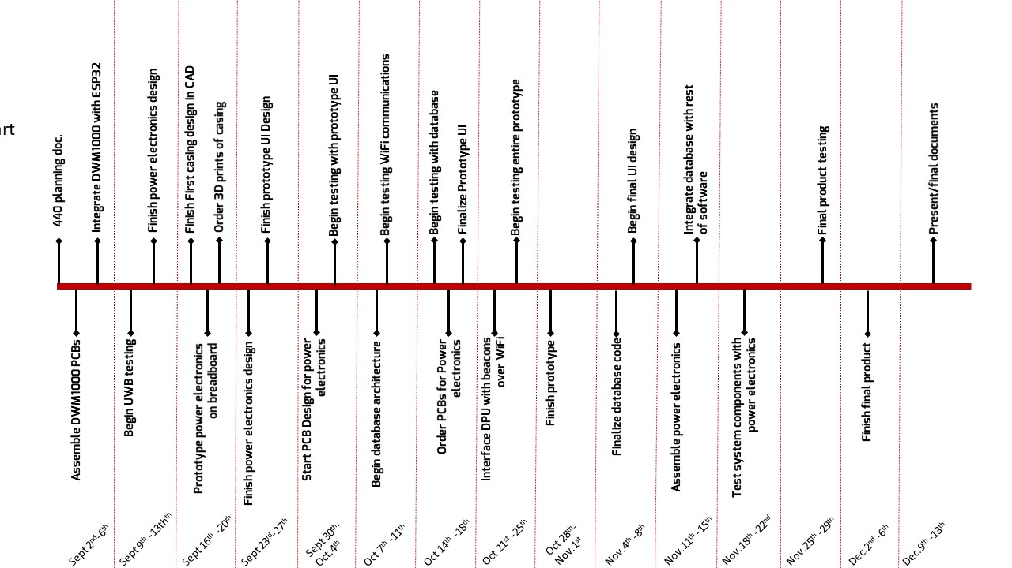
ENSC 440 Milestones
Introduction | Market Analysis | Technical Overview | Risk Assessment | Standards | Reflection | 440 Timeline | Summary
Notes:
Milestones chart
HW
UWB + esp32
Power/ charge
Rf harvester
Casing
SW
WIFi
DB
UI/style
Learn
docs

Slide 51
Summary & Concluding Remarks
Indoor Positioning System
UWB ToF vs. BLE RSSI
DPU to crunch numbers
Simplistic UI to reduce learning curve
Increasing efficiency of search and rescue efforts
More precise information
Better communication abilities
Modernizing safety in urban environments
Introduction | Market Analysis | Technical Overview | Risk Assessment | Standards | Reflection | 440 Timeline | Summary
Notes:
Overview

Slide 52
Acknowledgements
Quick Thank you to:
Scott’s Dad (Retired Firefighter/Fire Prevention)
Ryne’s Girlfriend’s Dad (Fire Chief)
Raymond Messier (North Shore SAR)
Royce Ng (Amazon Warehouse Safety/SAR)
Andrew Rawicz
Mohammad Akbari
Craig Scratchley

Slide 53
Demo

Slide 54
Technical Design Exploration Research

Slide 55
Technologies Considered
Ultrasonic
Infrared
GPS
BlueTooth Low Energy (BLE)
WiFi
2.4 GHz ISM band
Ultra-Wideband (UWB)

Slide 56
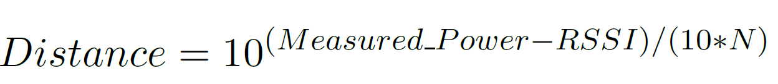
RF Ranging Techniques Considered
Time Difference Of Arrival (TDOA)
Received Signal Strength Indicator (RSSI)
Time of Flight (ToF)

Slide 57
Localization Methods Considered
Triangulation
2D Trilateration
3D Trilateration
Multilateration

Slide 58

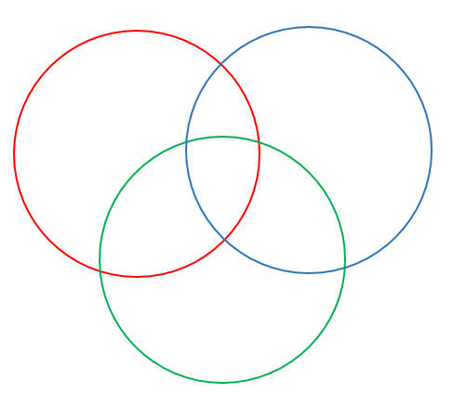

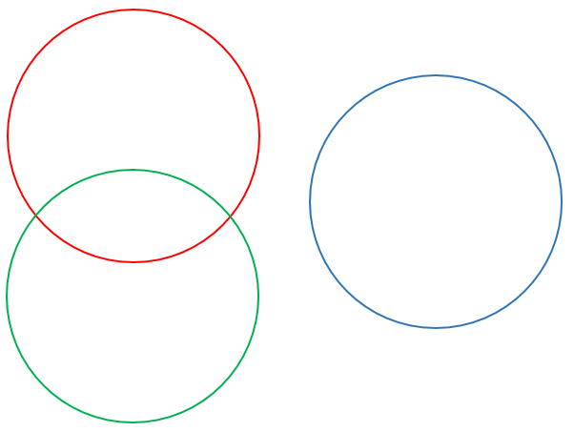
Trilateration Cases
Intersection Point
Intersection Area
Partial Intersection
No Intersection

Slide 59
RSSI Optimization Methods
Value Averaging
Rolling Averaging buffer
Particle filter
Swarm optimization
Monte carlo Methods
Finite Impulse Response (FIR) filter

Slide 60
Questions?

Slide 61
References
Statistics Canada. Survey of Commercial and Institutional Energy Use, 2014. [online] Available at: https://www150.statcan.gc.ca/n1/daily-quotidien/160916/dq160916c-eng.htm [Accessed 26 July. 2019].
Statistics Canada, "Fire-related deaths and persons injured, by type of structure", Www150.statcan.gc.ca, 2019. [Online]. Available: https://www150.statcan.gc.ca/t1/tbl1/en/tv.action?pid=3510019501. [Accessed: 26- July- 2019].
S. A.-H. M. A.-A. A. Alarifi A. Al-Salman M. Alsalem A. Alnafessah and H. Al-Khalifa. (2016) Ultra wideband indoor positioning technologies: Analysis and recent advances. [Online] Available: https://www.ncbi.nlm.nih.gov/pmc/articles/PMC4883398/pdf/ sensors-16-00707.pdf.[Accessed:14-Jun-2019]
BusinessWire. (2017) Elbit systems, general dynamics corporation, honeywell, leonardo ... - research and markets. [Online]. Available: [Online].Available:https://www.businesswire.com/news/home/20170901005591/en/ Search-Rescue-SAR-Equipment-Market---Forecast.[Accessed:14-Jun-2019]
Reuters. (2018) Indoor location market 2018 global trends, market share, industry size, growth, opportunities and forecast to 2023. [Online]. Available: [Online].Available:https: //www.reuters.com/brandfeatures/venture-capital/article?id=50849.[Accessed:14-Jun-2019]
https://github.com/rust-lang/rust
https://github.com/espressif/arduino-esp32/blob/master/LICENSE.md
https://github.com/actix/actix
https://github.com/actix/actix-web
https://github.com/DenisKolodin/yew
https://en.wikipedia.org/wiki/GNU_Compiler_Collection

Slide 62
Backup Slides

Slide 63
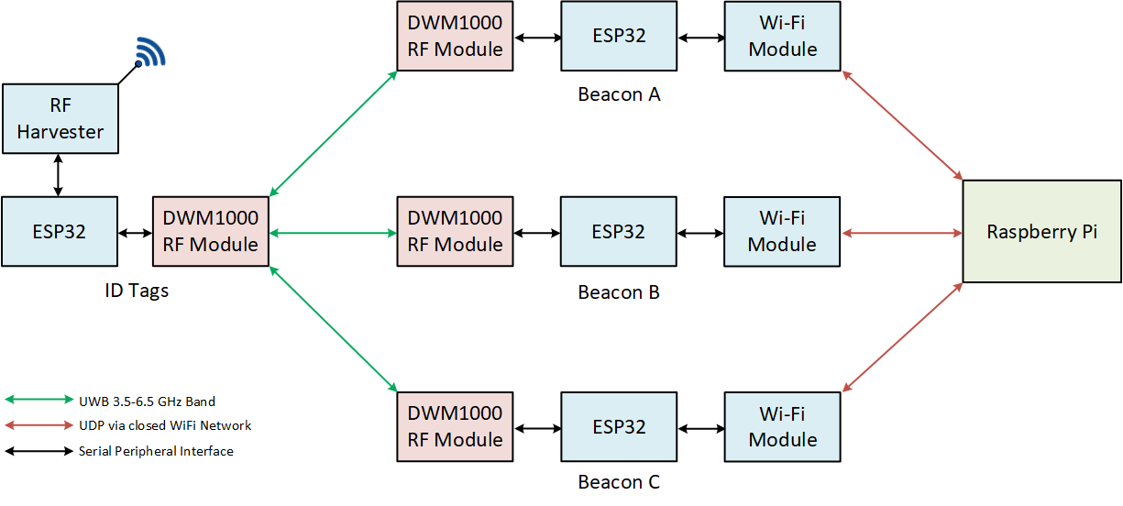
System Block Diagram

Slide 64
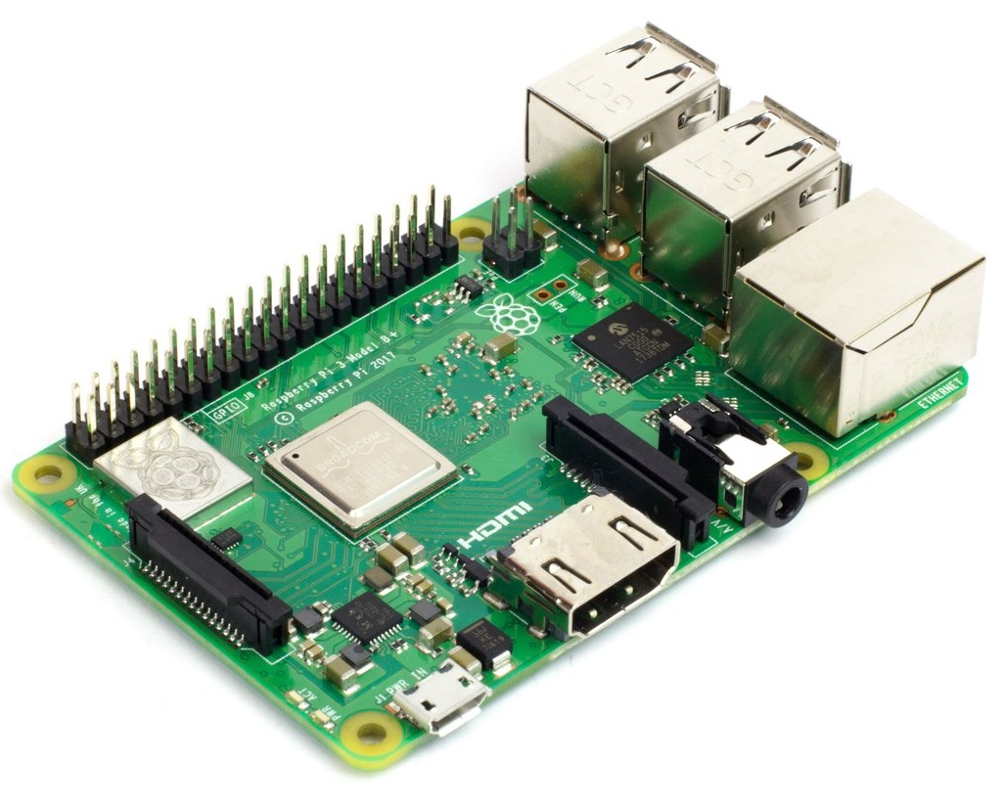
DPU - Raspberry Pi 3 B+
Arm Cortex-A53 Quad-core processor
64-Bit SoC @ 1.4 GHz
Dual-band wireless LAN
Linux Based OS
In Theory any SBC can be DPU

Slide 65
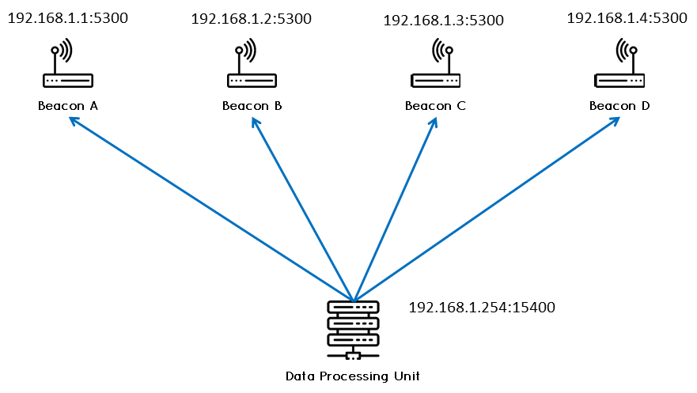
Beacons to DPU
User Datagram Protocol (UDP) Communication

Slide 66
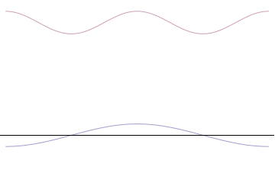
Heisenberg Uncertainty Principle
The timing and frequency of a signal cannot be localized simultaneously
𝝈_{t}𝝈_{f} ≥ 1/4𝛑
𝝈_{t} : width of a pulse
𝝈_{f} : range of frequencies (Bandwidth)
∴ Narrow pulse ⟹ Larger Bandwidth

Slide 67
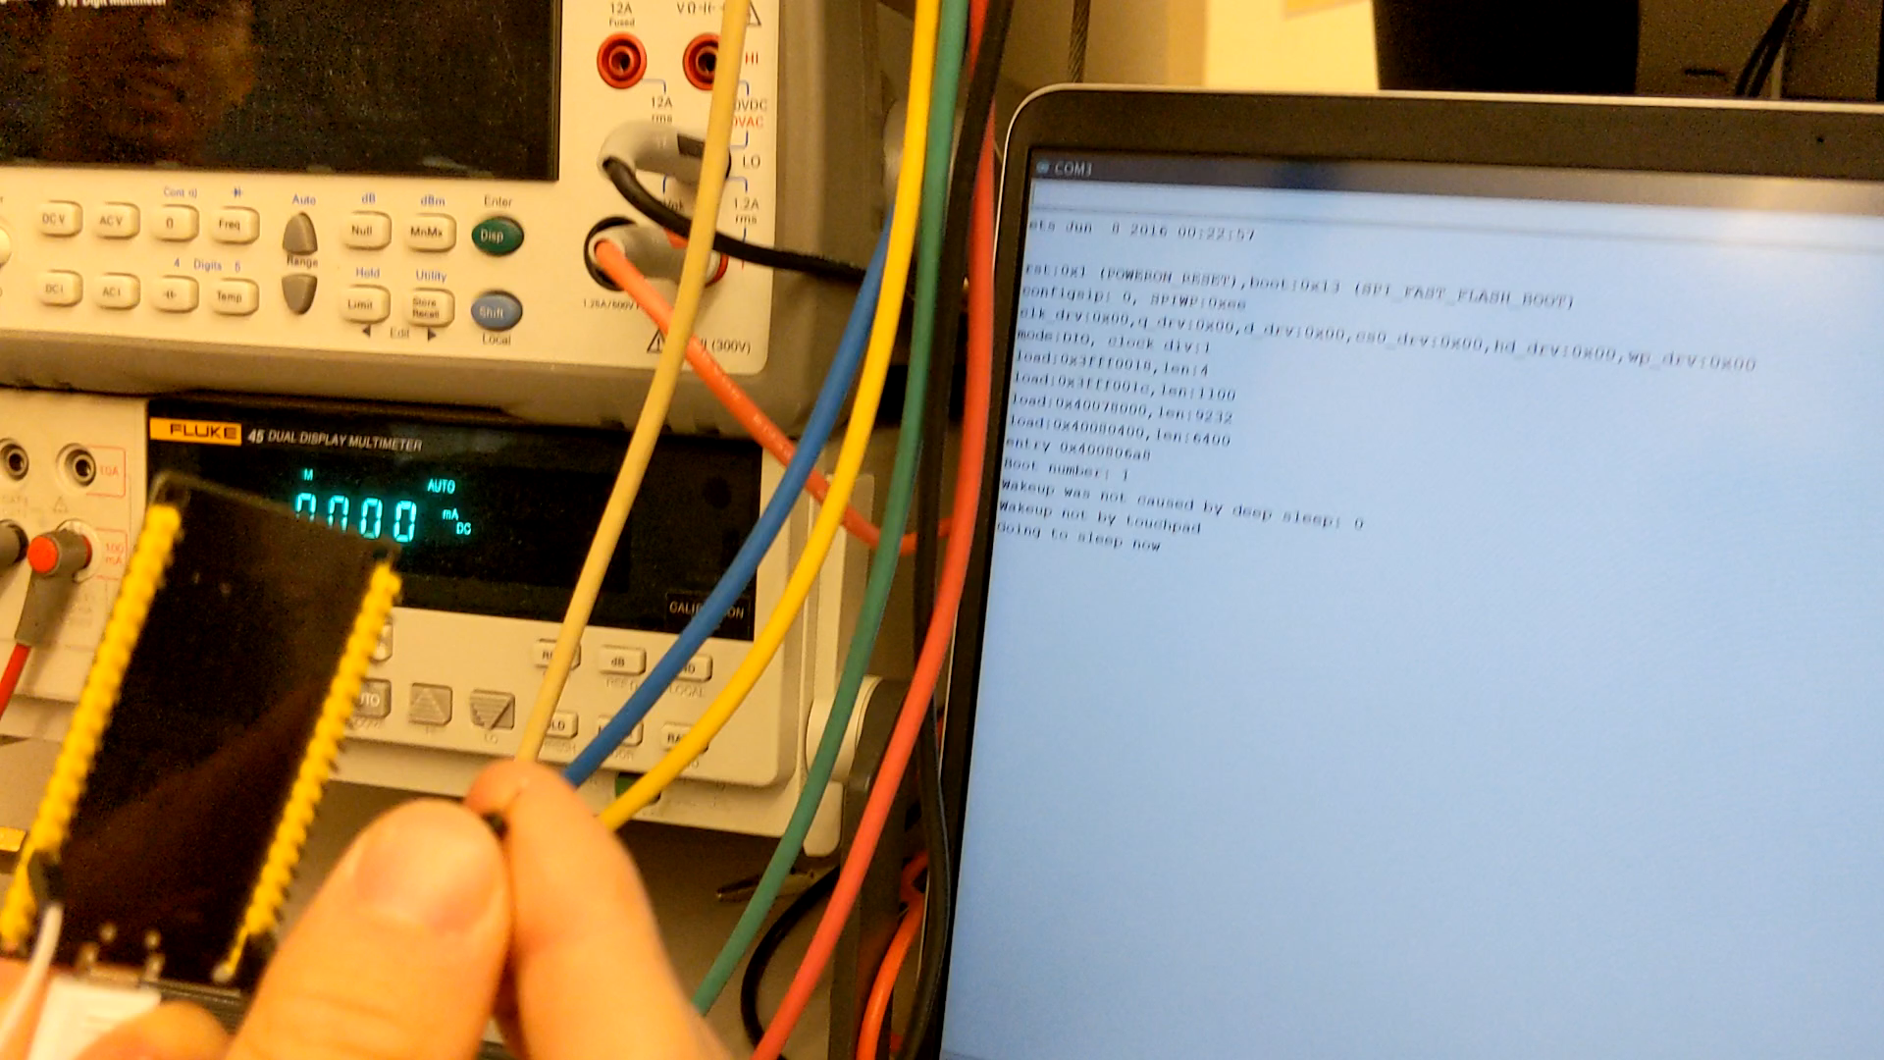
Demo: Deep Sleep Mode

Slide 68
Future Development

Slide 69
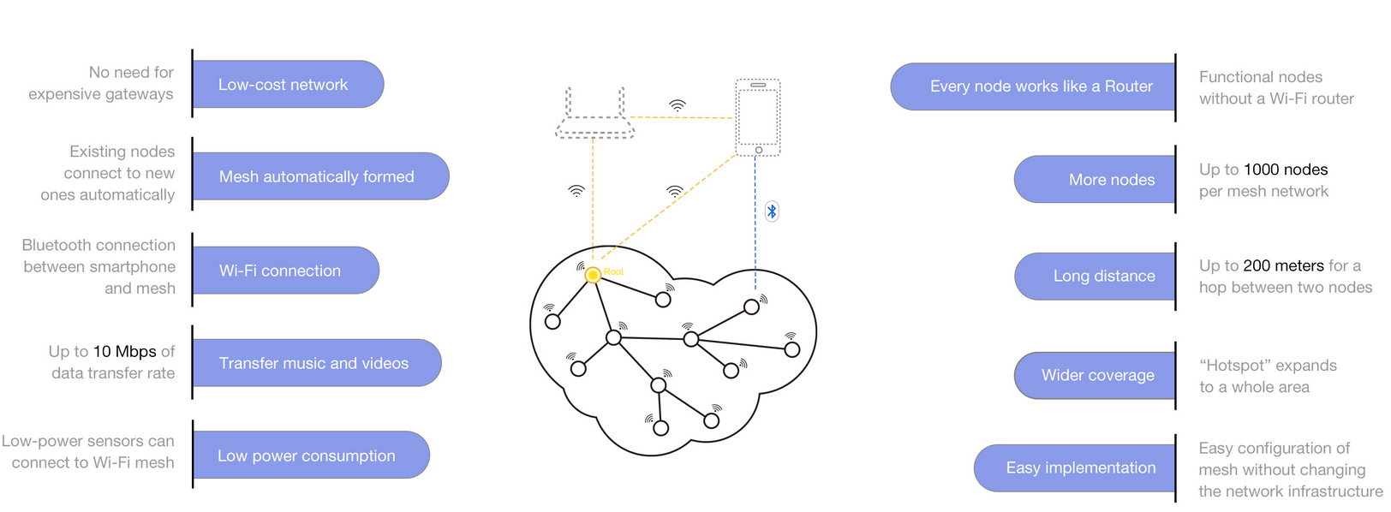
WiFi Mesh

Slide 70
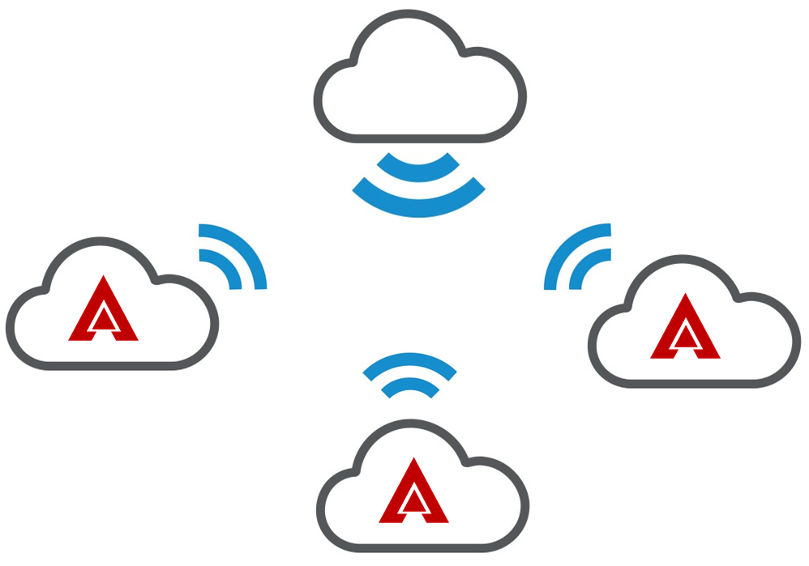
Cloud Management System

